Slide 1
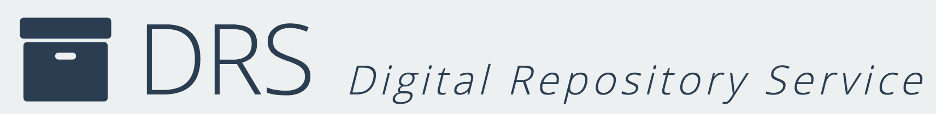
Digital Repositories
Gateways to Digital Stewardship
Sarah Sweeney
Digital Repository Manager
Northeastern University Libraries
repository.library.northeastern.edu
Notes:
Promotional Slide

Slide 2
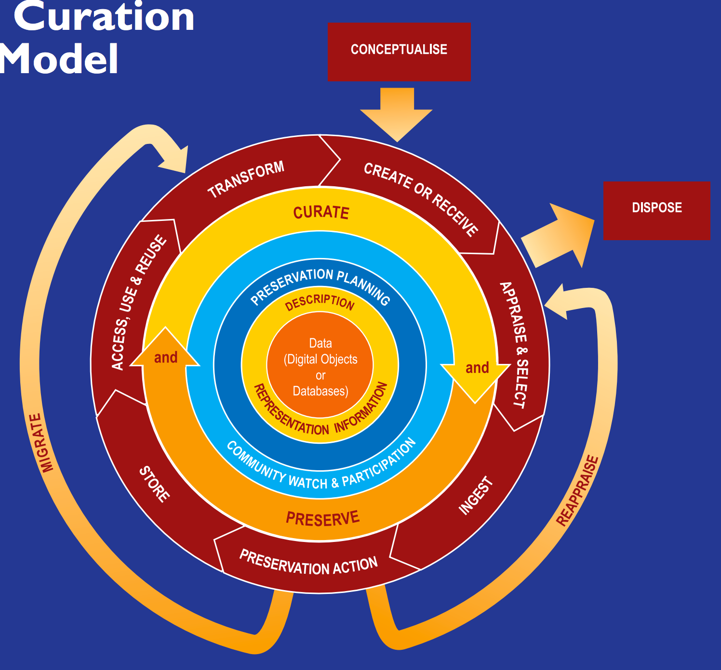
Digital Stewardship in Action
Plan
Collect
Describe
Maintain

Slide 3
The Relationship

Slide 4
What is Digital Stewardship

Slide 5
Imparting Principles

Slide 6
Limitations

Slide 7
References
DCC (Digital Curation Centre) Curation Lifecycle Model
Digital Stewardship: The one with all the definitions
Collaborative Approaches to Teaching Digital Stewardship: Classroom, Laboratory, and Internships

Slide 8
DRS
DRS Resources
Contact
https://repository.library.northeastern.edu
http://library.northeastern.edu
sj.sweeney@neu.edu
Sarah Sweeney
Digital Repository Manager
Northeastern University Libraries
repository.library.northeastern.edu
Notes:
Promotional Slide

